Slide 1



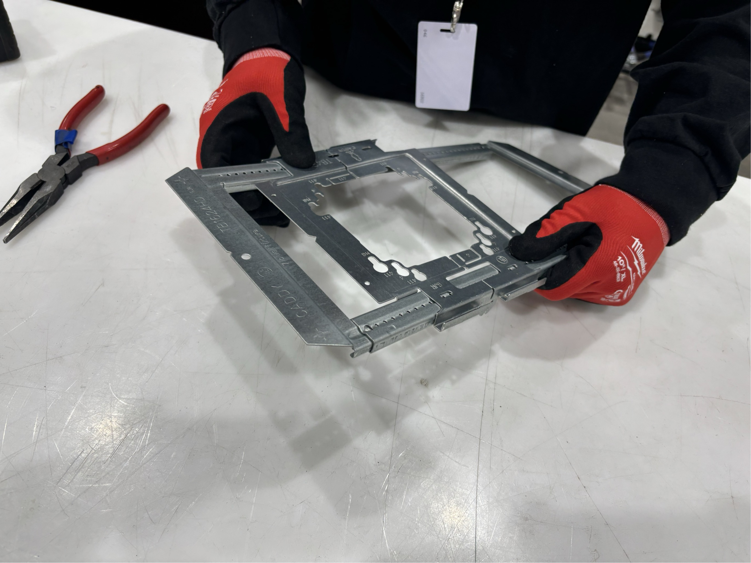
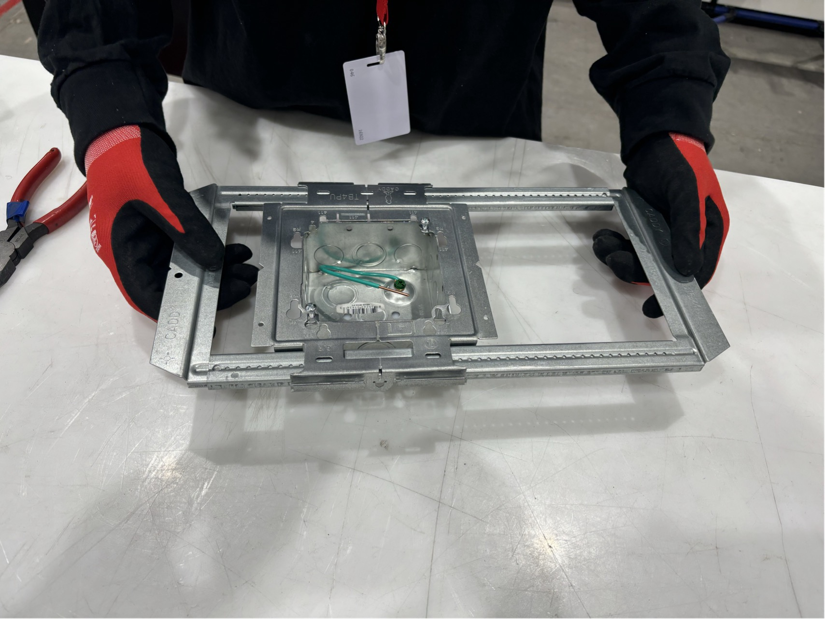
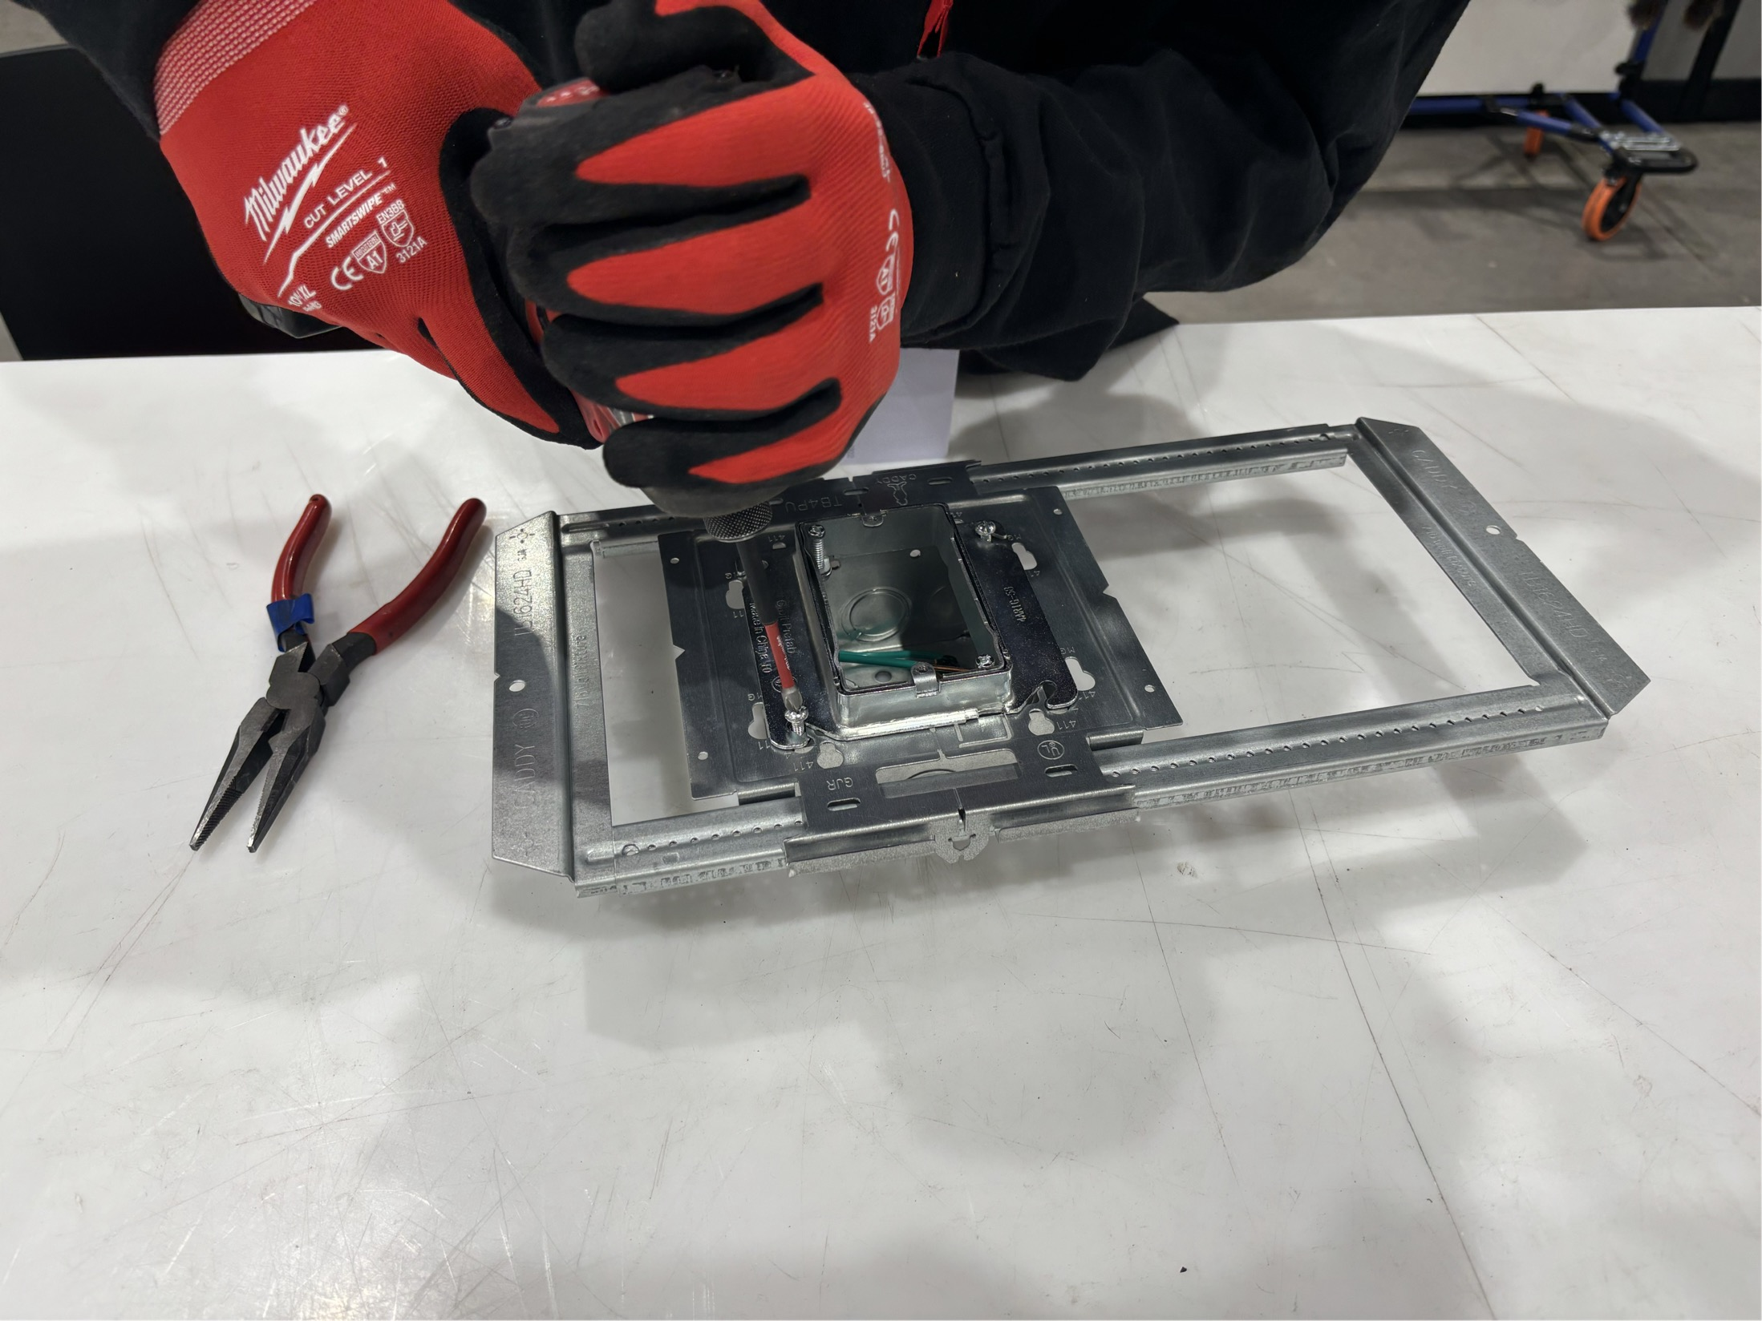

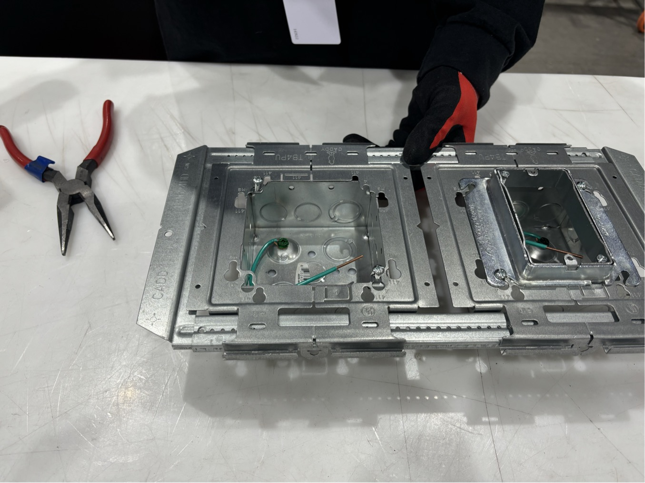
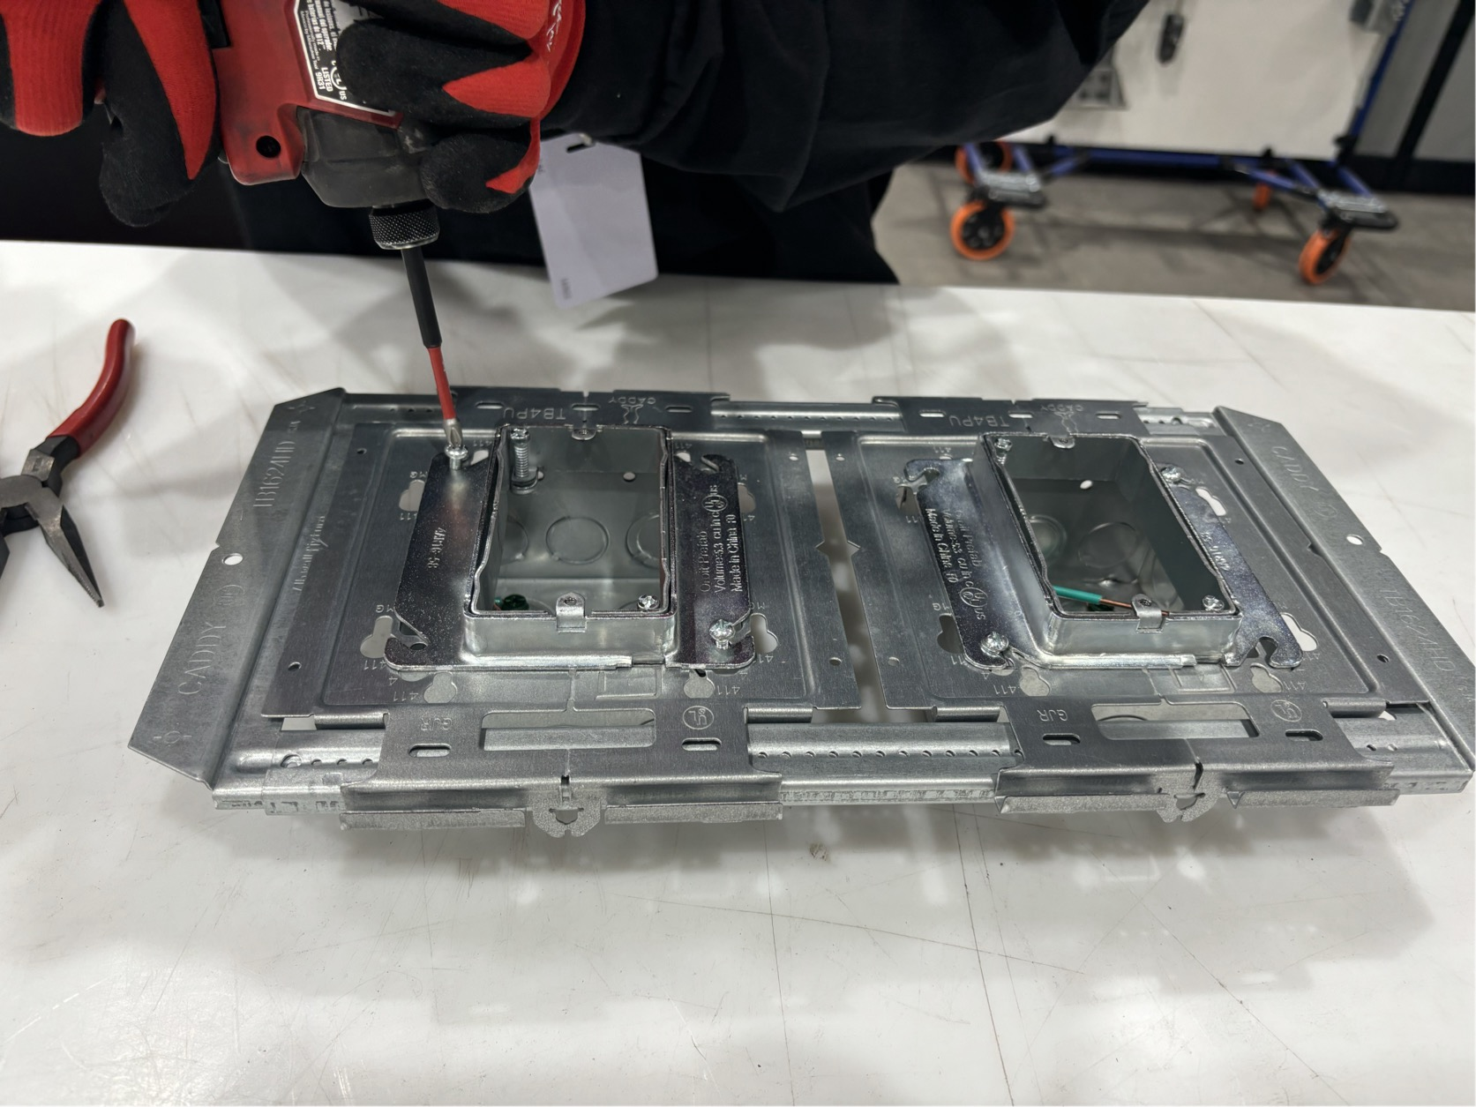
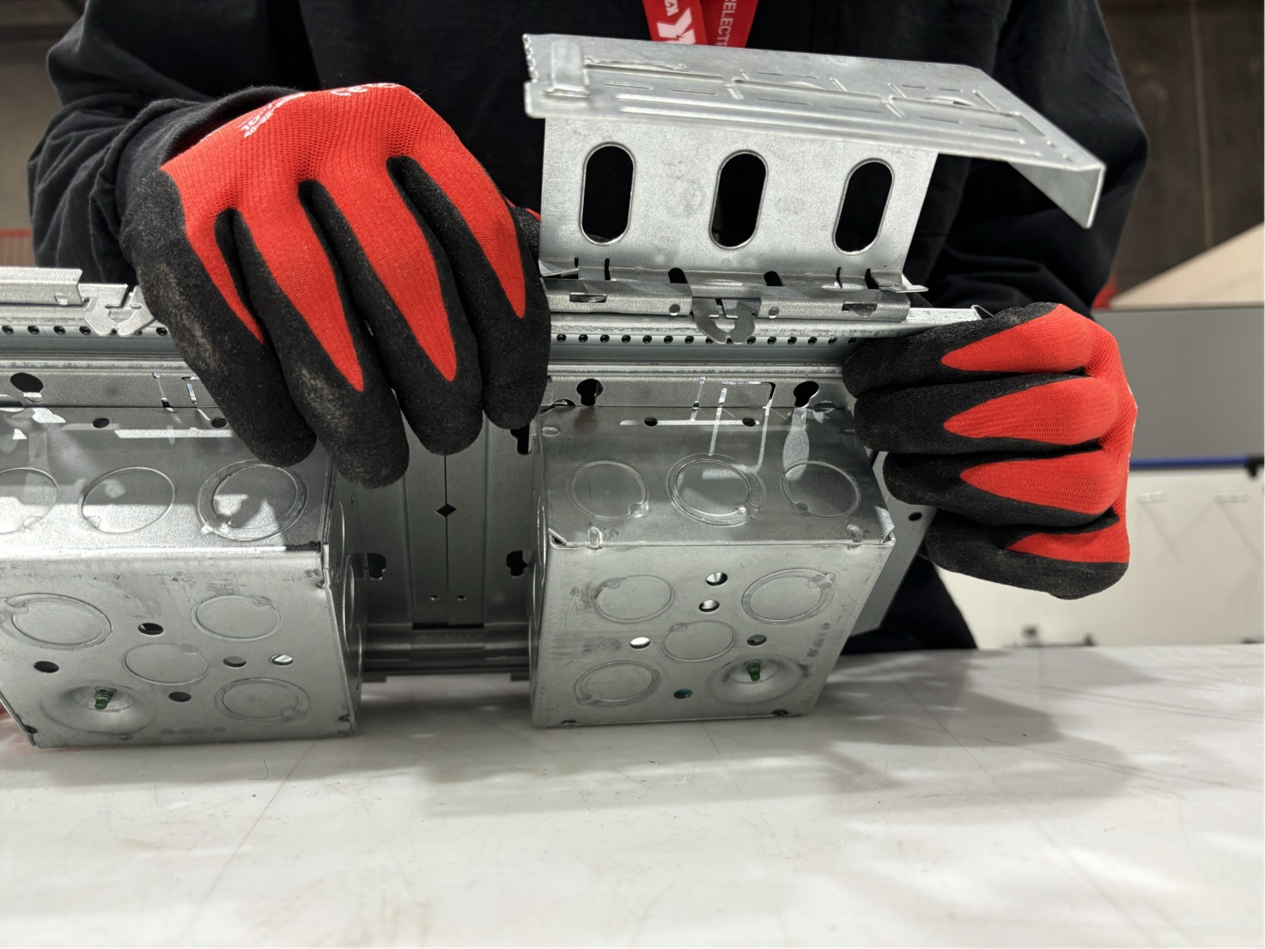
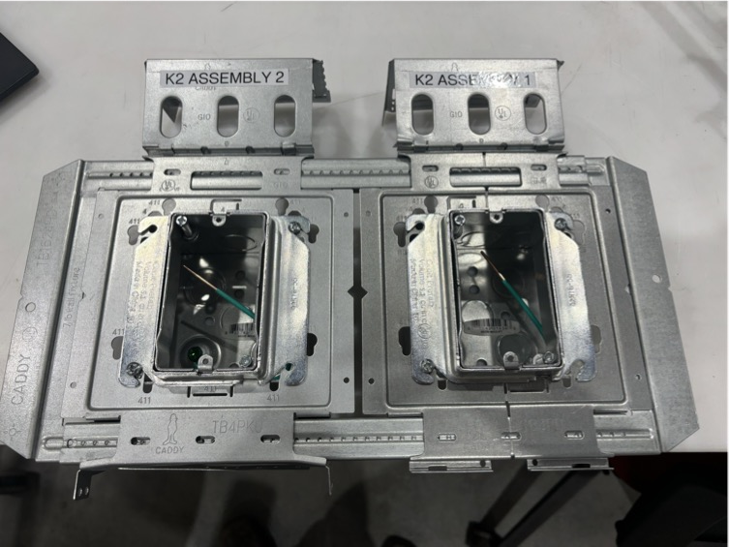
One-Point Lesson
1
2
3
Author: Pre-Fab
Process Name: SG-SG
In-Wall Box
Date: 9/30/2025
Rev. Number:
*Snap in a center plate onto the telescoping bracket
*Attach a 4sq. electrical box to the center plate by aligning the two screws.
*Attach a single gang mud ring to the 4sq. box by tightening the two screws.
4
5
6
Lesson
Addresses Performance Indicators
Safety
Quality
Delivery
Costs
Morale
X
X
*Attach another 4sq. electrical box to the center plate by aligning the two screws.
*Attach another single gang mud ring to the 4sq. box by tightening the two screws.
*Attach a FM4 bracket to left side assembly by inserting the two tabs to the center plate.
7
Cycle Time: 130 seconds per assembly/unit
*Attach another FM4 bracket to right side assembly by inserting the two tabs to the center plate.
*Finished Product

